Slide 1
CS F415: Data Mining
Yashvardhan Sharma

Slide 2
Today’s Outline
Data Preprocessing
Types of Data Sets
Why preprocess the data?
Data Quality

Slide 3
What is Data?
Collection of data objects and their attributes
An attribute is a property or characteristic of an object
Examples: eye color of a person, temperature, etc.
Attribute is also known as variable, field, characteristic, or feature
A collection of attributes describe an object
Object is also known as record, point, case, sample, entity, or instance
Attributes
Objects

Slide 4
Attribute Values
Attribute values are numbers or symbols assigned to an attribute
Distinction between attributes and attribute values
Same attribute can be mapped to different attribute values
Example: height can be measured in feet or meters
Different attributes can be mapped to the same set of values
Example: Attribute values for ID and age are integers
But properties of attribute values can be different
ID has no limit but age has a maximum and minimum value

Slide 5
Measurement of Length
The way you measure an attribute is somewhat may not match the attributes properties.

Slide 6
Properties of Attribute Values
The type of an attribute depends on which of the following properties it possesses:
Distinctness: = ≠
Order: < >
Addition: + -
Multiplication: * /
Nominal attribute: distinctness
Ordinal attribute: distinctness & order
Interval attribute: distinctness, order & addition
Ratio attribute: all 4 properties

Slide 7
Types of Attributes
There are different types of attributes
Nominal
Examples: ID numbers, eye color, zip codes
Ordinal
Examples: rankings (e.g., taste of potato chips on a scale from 1-10), grades, height in {tall, medium, short}
Interval
Examples: calendar dates, temperatures in Celsius or Fahrenheit.
Ratio
Examples: temperature in Kelvin, length, time, counts

Slide 8
Attribute Type
Description
Examples
Operations
Nominal
The values of a nominal attribute are just different names, i.e., nominal attributes provide only enough information to distinguish one object from another. (=, ≠)
zip codes, employee ID numbers, eye color, sex: {male, female}
mode, entropy, contingency correlation, χ² test
Ordinal
The values of an ordinal attribute provide enough information to order objects. (<, >)
hardness of minerals, {good, better, best}, grades, street numbers
median, percentiles, rank correlation, run tests, sign tests
Interval
For interval attributes, the differences between values are meaningful, i.e., a unit of measurement exists. (+, - )
calendar dates, temperature in Celsius or Fahrenheit
mean, standard deviation, Pearson's correlation, t and F tests
Ratio
For ratio variables, both differences and ratios are meaningful. (*, /)
temperature in Kelvin, monetary quantities, counts, age, mass, length, electrical current
geometric mean, harmonic mean, percent variation

Slide 9
Attribute Level
Transformation
Comments
Nominal
Any permutation of values
If all employee ID numbers were reassigned, would it make any difference?
Ordinal
An order preserving change of values, i.e., new_value = f(old_value) where f is a monotonic function.
An attribute encompassing the notion of good, better best can be represented equally well by the values {1, 2, 3} or by { 0.5, 1, 10}.
Interval
new_value =a * old_value + b where a and b are constants
Thus, the Fahrenheit and Celsius temperature scales differ in terms of where their zero value is and the size of a unit (degree).
Ratio
new_value = a * old_value
Length can be measured in meters or feet.

Slide 10
Discrete and Continuous Attributes
Discrete Attribute
Has only a finite or countably infinite set of values
Examples: zip codes, counts, or the set of words in a collection of documents
Often represented as integer variables.
Note: binary attributes are a special case of discrete attributes
Continuous Attribute
Has real numbers as attribute values
Examples: temperature, height, or weight.
Practically, real values can only be measured and represented using a finite number of digits.
Continuous attributes are typically represented as floating-point variables.

Slide 11
Important Characteristics of Structured Data
Dimensionality
Curse of Dimensionality
Sparsity
Only presence counts
Resolution
Patterns depend on the scale

Slide 12
Types of data sets
Record
Data Matrix
Document Data
Transaction Data
Graph
World Wide Web
Molecular Structures
Ordered
Spatial Data
Temporal Data
Sequential Data
Genetic Sequence Data

Slide 13
Record Data
Data that consists of a collection of records, each of which consists of a fixed set of attributes

Slide 14
Transaction Data
A special type of record data, where
each record (transaction) involves a set of items.
For example, consider a grocery store. The set of products purchased by a customer during one shopping trip constitute a transaction, while the individual products that were purchased are the items.

Slide 15
Data Matrix
If data objects have the same fixed set of numeric attributes, then the data objects can be thought of as points in a multi-dimensional space, where each dimension represents a distinct attribute
Such data set can be represented by an m by n matrix, where there are m rows, one for each object, and n columns, one for each attribute

Slide 16
Document – term matrix
Each document becomes a ‘term’ vector,
each term is a component (attribute) of the vector,
the value of each component is the number of times the corresponding term occurs in the document.

Slide 17
Graph Data
Examples: Generic graph and HTML Links

Slide 18
Chemical Data
Benzene Molecule: C₆H₆

Slide 19
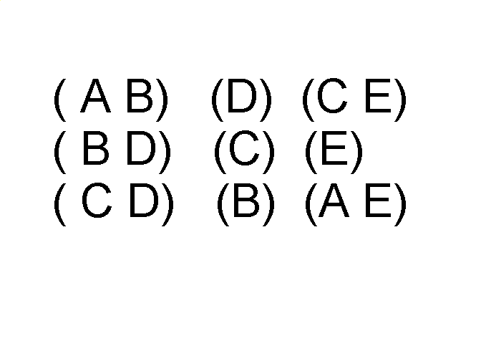
Ordered Data
Sequences of transactions
Items/Events
An element of the sequence

Slide 20
Ordered Data
Genomic sequence data

Slide 21
Ordered Data
Spatio-Temporal Data
Average Monthly Temperature of land and ocean

Slide 23
Why Data Preprocessing?
Data in the real world is dirty
incomplete: lacking attribute values, lacking certain attributes of interest, or containing only aggregate data
noisy: containing errors or outliers
inconsistent: containing discrepancies in codes or names
No quality data, no quality mining results!
Quality decisions must be based on quality data
Data warehouse needs consistent integration of quality data
Required for both OLAP and Data Mining!

Slide 24
Why can Data be Incomplete?
Attributes of interest are not available (e.g., customer information for sales transaction data)
Data were not considered important at the time of transactions, so they were not recorded!
Data not recorded because of misunderstanding or malfunctions
Data may have been recorded and later deleted!
Missing/unknown values for some data

Slide 25
Why can Data be Noisy/Inconsistent?
Faulty instruments for data collection
Human or computer errors
Errors in data transmission
Technology limitations (e.g., sensor data come at a faster rate than they can be processed)
Inconsistencies in naming conventions or data codes (e.g., 2/5/2018 could be 2 May 2018 or 5 Feb 2018)
Duplicate tuples, which were received twice should also be removed

Slide 26
Multi-Dimensional Measure of Data Quality
A well-accepted multidimensional view:
Accuracy
Completeness
Consistency
Timeliness
Believability
Value added
Interpretability
Accessibility
Broad categories:
intrinsic, contextual, representational, and accessibility.

Slide 27
Major Tasks in Data Preprocessing
outliers=exceptions!
Data cleaning
Fill in missing values, smooth noisy data, identify or remove
outliers, and resolve inconsistencies
Data integration
Integration of multiple databases, data cubes, or files
Data transformation
Normalization and aggregation
Data reduction
Obtains reduced representation in volume but produces the same or similar analytical results
Data discretization
Part of data reduction but with particular importance, especially for numerical data

Slide 28
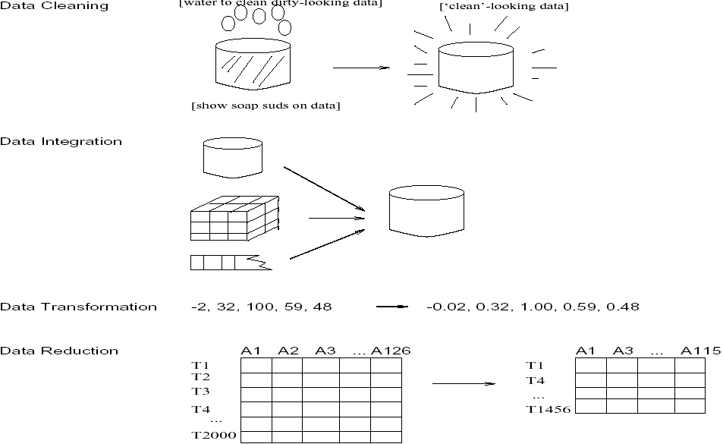
Forms of data preprocessing

Slide 29
Data Quality
What kinds of data quality problems?
How can we detect problems with the data?
What can we do about these problems?
Examples of data quality problems:
Noise and outliers
missing values
duplicate data

Slide 30
Data Cleaning
Importance
“Data cleaning is one of the three biggest problems in data warehousing”—Ralph Kimball
“Data cleaning is the number one problem in data warehousing”—DCI survey
Data cleaning tasks
Fill in missing values
Identify outliers and smooth out noisy data
Correct inconsistent data
Resolve redundancy caused by data integration

Slide 31
Missing Data
Data is not always available
E.g., many tuples have no recorded value for several attributes, such as customer income in sales data
Missing data may be due to
equipment malfunction
inconsistent with other recorded data and thus deleted
data not entered due to misunderstanding
certain data may not be considered important at the time of entry
not register history or changes of the data
Missing data may need to be inferred.

Slide 32
Missing Values
Reasons for missing values
Information is not collected (e.g., people decline to give their age and weight)
Attributes may not be applicable to all cases (e.g., annual income is not applicable to children)
Handling missing values
Eliminate Data Objects
Estimate Missing Values
Ignore the Missing Value During Analysis
Replace with all possible values (weighted by their probabilities)

Slide 33
How to Handle Missing Data?
Ignore the tuple: usually done when class label is missing (assuming the tasks in classification—not effective when the percentage of missing values per attribute varies considerably.
Fill in the missing value manually: tedious + infeasible?
Fill in it automatically with
a global constant : e.g., “unknown”, a new class?!
the attribute mean
the attribute mean for all samples belonging to the same class: smarter
the most probable value: inference-based such as Bayesian formula or decision tree

Slide 34
Noisy Data
Noise: random error or variance in a measured variable
Incorrect attribute values may due to
faulty data collection instruments
data entry problems
data transmission problems
technology limitation
inconsistency in naming convention
Other data problems which requires data cleaning
duplicate records
incomplete data
inconsistent data

Slide 35
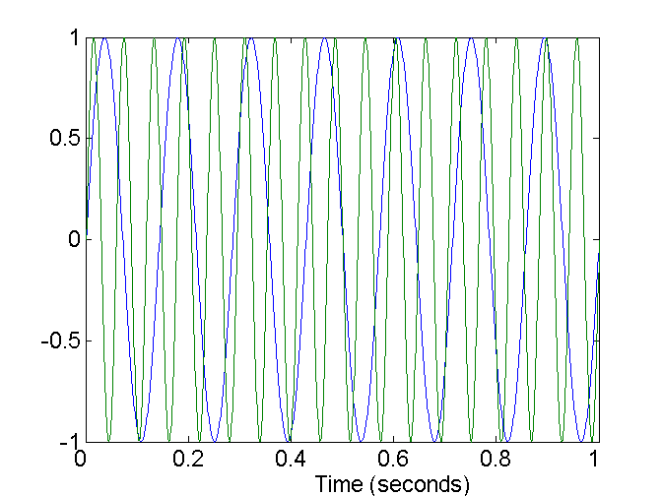
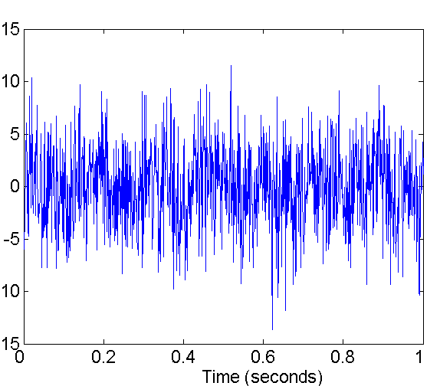
Noise
Noise refers to modification of original values
Examples: distortion of a person’s voice when talking on a poor phone
Two Sine Waves
Two Sine Waves + Noise

Slide 36
How to Handle Noisy Data?
Binning method:
first sort data and partition into (equi-depth) bins
then one can smooth by bin means, smooth by bin median, smooth by bin boundaries, etc.
Clustering
detect and remove outliers
Combined computer and human inspection
detect suspicious values and check by human (e.g., deal with possible outliers)
Regression
smooth by fitting the data into regression functions

Slide 37
Simple Discretization Methods: Binning
Equal-width (distance) partitioning:
Divides the range into N intervals of equal size: uniform grid
if A and B are the lowest and highest values of the attribute, the width of intervals will be: W = (B –A)/N.
The most straightforward, but outliers may dominate presentation
Skewed data is not handled well.
Equal-depth (frequency) partitioning:
Divides the range into N intervals, each containing approximately same number of samples
Good data scaling
Managing categorical attributes can be tricky.

Slide 38
Binning Methods for Data Smoothing
Sorted data (e.g., by price)
4, 8, 9, 15, 21, 21, 24, 25, 26, 28, 29, 34
Partition into (equi-depth) bins:
Bin 1: 4, 8, 9, 15
Bin 2: 21, 21, 24, 25
Bin 3: 26, 28, 29, 34
Smoothing by bin means:
Bin 1: 9, 9, 9, 9
Bin 2: 23, 23, 23, 23
Bin 3: 29, 29, 29, 29
Smoothing by bin boundaries:
Bin 1: 4, 4, 4, 15
Bin 2: 21, 21, 25, 25
Bin 3: 26, 26, 26, 34

Slide 39
Cluster Analysis

Slide 40
Regression
y
Y1
Y1’
y = x + 1
X1
x

Slide 41
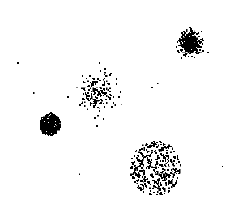
Outliers
Outliers are data objects with characteristics that are considerably different than most of the other data objects in the data set

Slide 42
Duplicate Data
Data set may include data objects that are duplicates, or almost duplicates of one another
Major issue when merging data from heterogeneous sources
Examples:
Same person with multiple email addresses
Data cleaning
Process of dealing with duplicate data issues

Slide 43
Data Preprocessing
Aggregation
Sampling
Dimensionality Reduction
Feature subset selection
Feature creation
Discretization and Binarization
Attribute Transformation

